Slide 1
Full Stack Application Development
Securing API
Security
Basic Authentication
Akshaya Ganesan

Slide 2
Basic Authentication
API Keys

Slide 3
Security
Authentication and authorization are two foundation elements of security:
Authentication is the process of verifying who a user is.
Authorization is the process of verifying what they have access to.

Slide 4
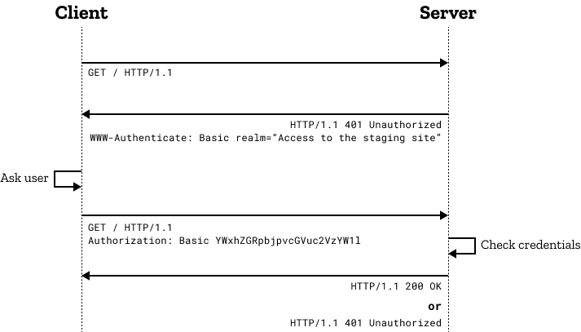
Basic Authentication
HTTP provides a general framework for access control and authentication.
In basic HTTP authentication, a request contains a header field in the form of
Authorization: Basic <credentials>
The credentials is the Base64 encoding of username and password joined by a single colon
Basic authentication is typically used in conjunction with HTTPS to provide confidentiality.
Image Ref:https://developer.mozilla.org/en-US/docs/Web/HTTP/Authentication

Slide 5
Basic Authentication
Here are some reasons why it is still used:
Simplicity
Compatibility
Statelessness
Limitations
Security
Single Factor
Risk of Credential Exposure

Slide 6
API Keys
An API key is a unique identifier used to authenticate and authorize the access to an API
Instead of a username and password, the client application is issued a unique API key, typically a long alphanumeric string.
The API key is sent in the HTTP request as a parameter in the query string or the request headers
(e.g., api_key=your_api_key or Authorization: API-Key your_api_key).
API keys are commonly used for machine-to-machine communication or applications interacting with the API.
Some APIs use API keys to enforce rate limits.

Slide 7
API Keys
Security: Treat API keys as sensitive information. Avoid hardcoding them in client-side code or exposing them publicly.
Rotation: Regularly rotate API keys to enhance security. You can invalidate a key and issue a new one if a key is compromised.
Scopes: Consider using different keys for different purposes (e.g., read-only vs. administrative access).
HTTPS: Always use HTTPS to transmit API keys securely.
Examples: Google Maps API, Cloud Services.

Slide 8
Basic Authentication
API Keys

Slide 9
Thank You!

